Slide 1
Azure and Office 365 DevCamp – Developer Tools

Slide 2
Agenda
Developer Environments
Tools
Language Specific SDKs

Slide 3
Developer Environment Options
Local
Windows
Linux/OSX
Cloud
Developer images

Slide 4
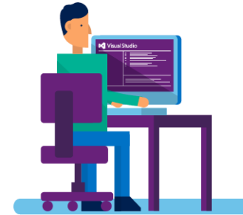
A Suite of Azure Developer Tools and SDKs
Visual Studio 2015, “15” and 2013
App Services
Connected Services
WebJobs
PowerShell Editing
Debugging
Integrated DevOps
Azure SDK for .NET & Java
Cloud Services
Azure Resource Manager (ARM, IaaS VMs)
Azure Resource Optics via Cloud Explorer
Diagnostics for Cloud Services, VMs and VMSS
Data Factory Tools
Visual Studio Tools for Docker – Preview
Azure Service Fabric Tools for Visual Studio
Language SDKs
Azure SDK for Java
Azure SDK for Node.js
Azure SDK for Python
Azure SDK for Ruby
Azure SDK for PHP
Azure SDK for Go
Command-Line Tools
Azure Command-Line Interface
Azure PowerShell
Standalone Tools
Visual Studio Code and extensions (ARM, ASP.NET Core)
Microsoft Azure Storage Explorer
Azure Toolkit for Eclipse and IntelliJ
Docker Tools (Visual Studio Code, Visual Studio Team Services, and Yeoman Generator for Docker)
Azure DevTest Labs
Java
PHP
Data
App
Notes:
We release a lot of different tools to help you develop apps for Azure.
There is a lot you can do, without having to leave Visual Studio:
restart servers in Azure directly from Visual Studio
debug you web application or Service Fabric services running in Azure, directly from Visual Studio.
configure diagnostics settings on your cloud services from Visual Studio.
even create new resources, like VMs, web apps and storage account for your applications.
We even provide local-only emulators and
When you need to interact with Azure services in your applications, you are almost certain to find the programming language you use among our SDKs.
If you are more to CLI and PowerShell, we have great support for that as well.
We also so have standalone tools like Storage Explorer to help you.

Slide 5


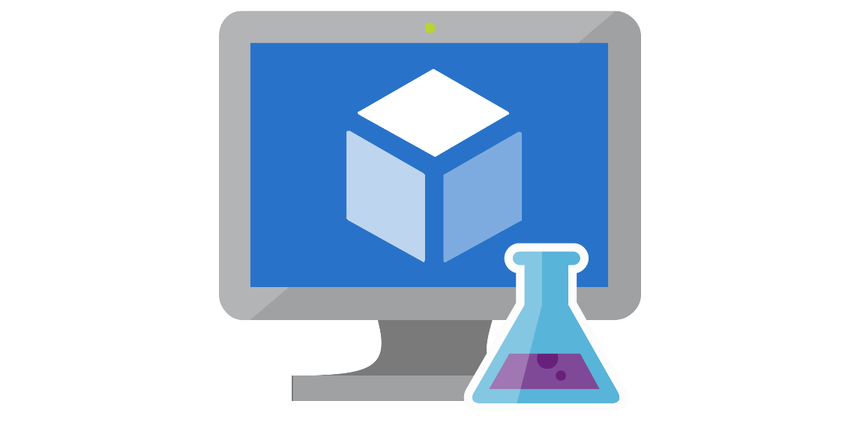


Dev Box in the Cloud

Slide 6
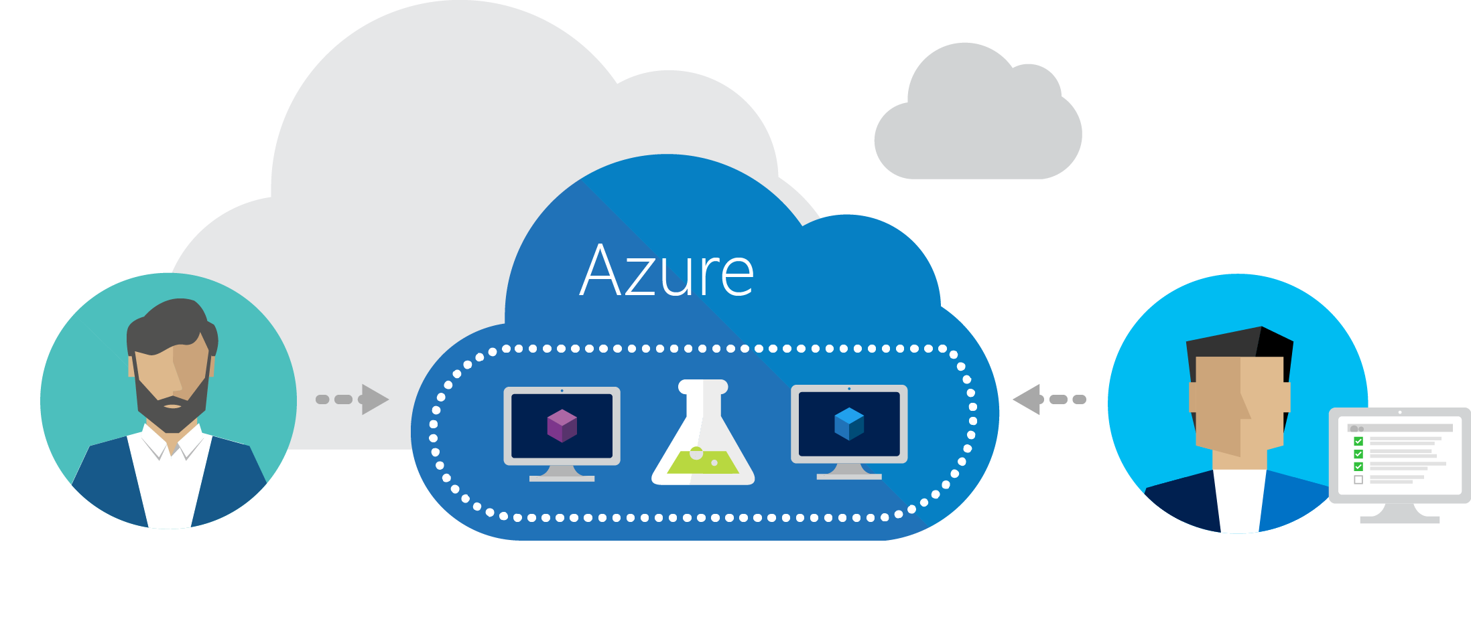
Azure DevTest Labs
Try at http://aka.ms/dtl
Fast, easy, and lean dev-test environments in Azure.
Specifically for your team.
On demand.

Slide 7
Azure Dev Centers
Starting point including SDKs, sample code, and guidance around application development on Azure
.NET | https://azure.microsoft.com/en-us/develop/net/
NodeJS | https://azure.microsoft.com/en-us/develop/nodejs/
Java | https://azure.microsoft.com/en-us/develop/java/
iOS | https://azure.microsoft.com/en-us/develop/mobile/ios/
PHP | https://azure.microsoft.com/en-us/develop/php/
Python | https://azure.microsoft.com/en-us/develop/python/
Ruby | https://azure.microsoft.com/en-us/develop/ruby/

Slide 8
Tools

Slide 9
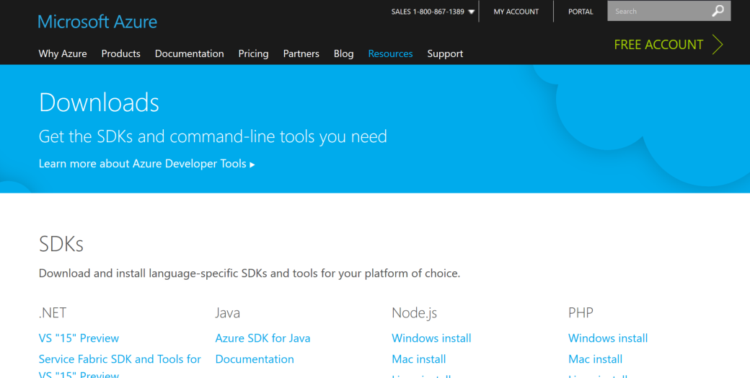
Tools and SDKs
azure.microsoft.com/downloads/

Slide 10
Azure Tools
Azure Tools
https://azure.com/tools
Storage Explorer
http://storageexplorer.com
Visual Studio
https://www.visualstudio.com/vs/azure-tools
Visual Studio Code
https://code.visualstudio.com
Azure Powershell
http://aka.ms/webpi-azps
Notes:
Before you leave:
Remember how you can build great applications, using our suite of open and flexible tools and unlock the possibilities the cloud has brought to us.
By now you should be well aware, that we have tools available that fit’s your needs and across tasks, roles and preference of OS.
Make sure to use the tools you know and love
get what you need at this website
sign-up for your Azure benefits and start building cloud apps today

Slide 11
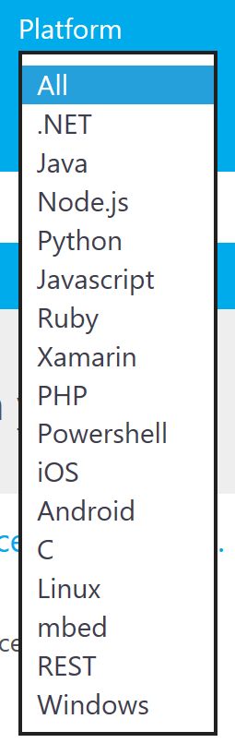
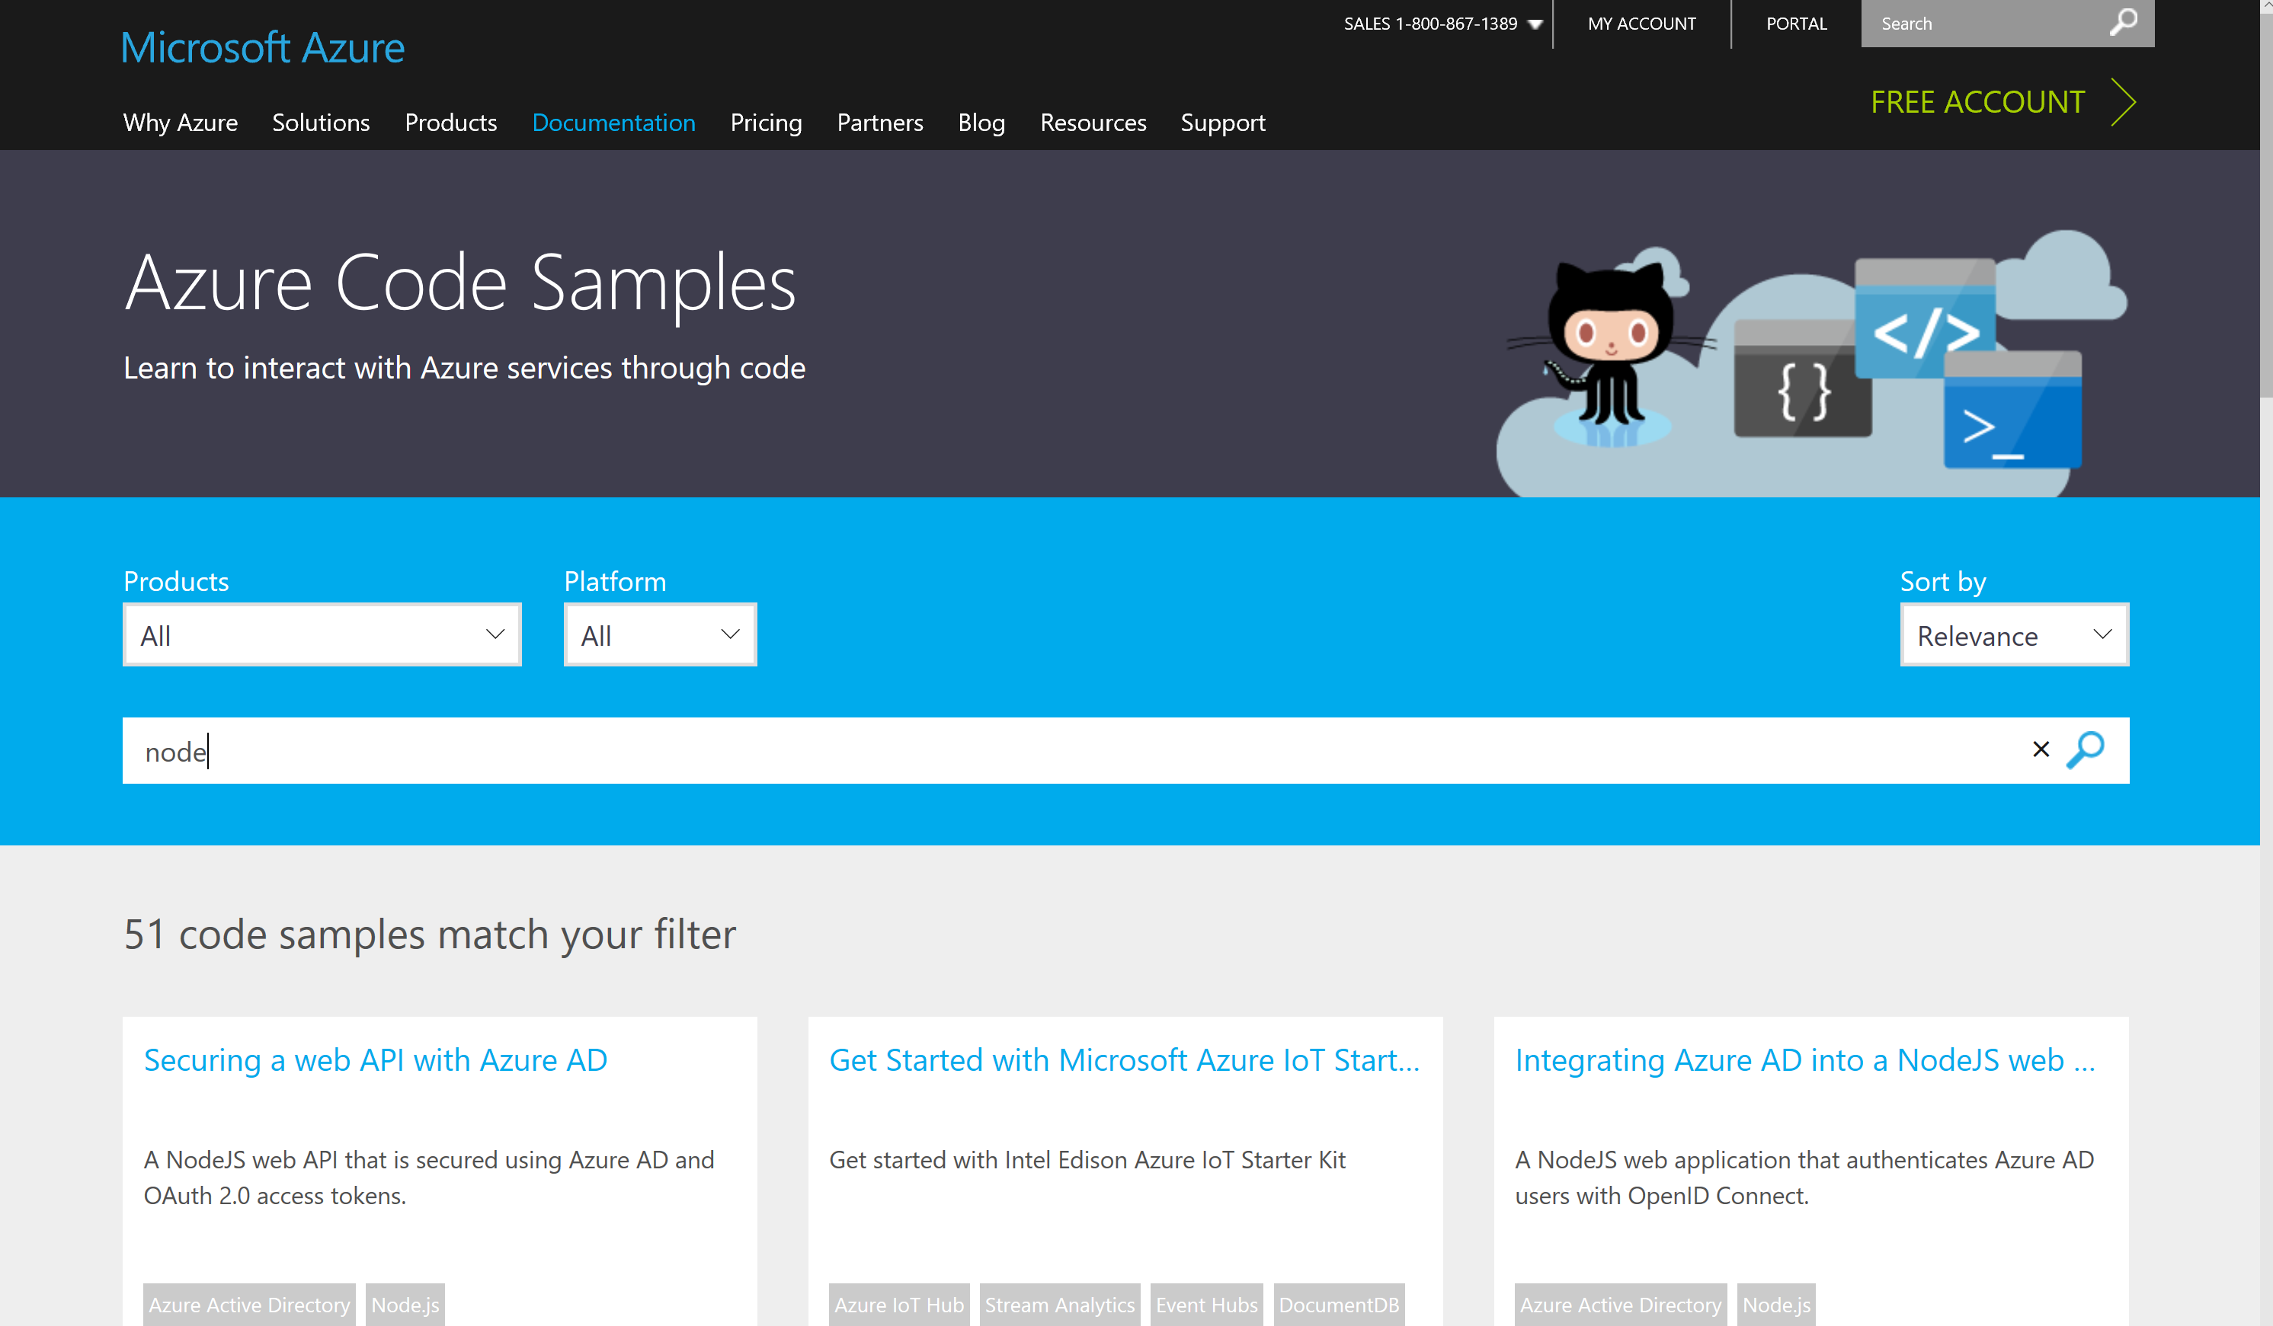
Code Samples
https://azure.microsoft.com/documentation/samples/

Slide 12
Azure Command-Line Interface (CLI)
A Commandline experience to manipulate Azure
Available on Linux, Mac, Windows, etc.
Installed via npm, installer or Docker container
https://azure.microsoft.com/en-us/documentation/articles/xplat-cli-install/
Coming soon: Azure CLI 2.0 Preview

Slide 13
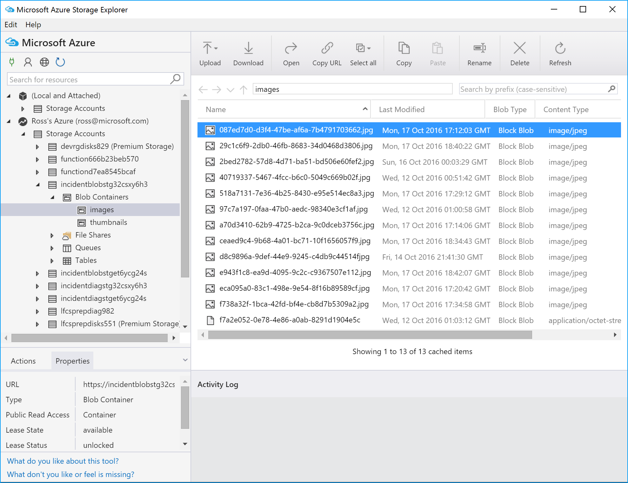
Azure Storage Explorer
View and manage items in Azure Storage
Upload and download blobs
View and edit:
Storage Accounts
Blob Containers
Blobs
Queues
File Shares
Tables
http://storageexplorer.com

Slide 14
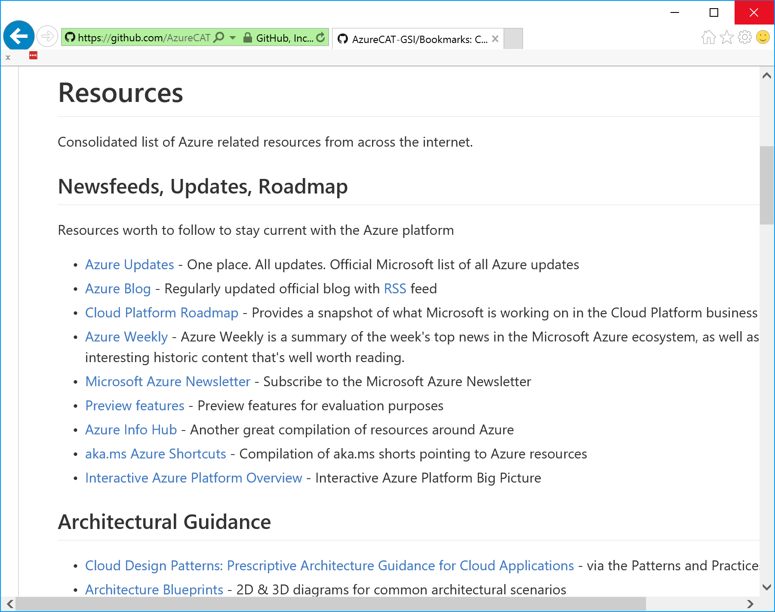
Links and resources
https://github.com/AzureCAT-GSI/Bookmarks
News and Updates
Architectural Guidance
Billing
Tools
Migration
Azure Resource Manager
Partner Center
Coding
Books & Videos

Slide 15
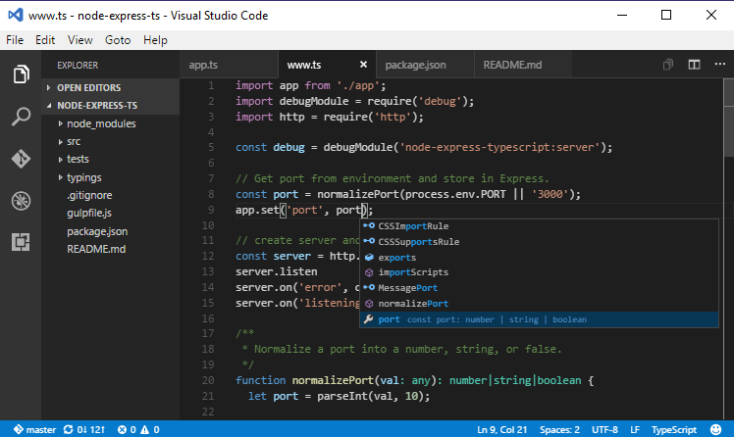
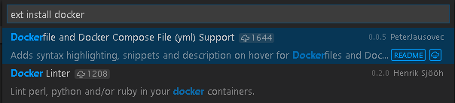
Visual Studio Code
Cross-Platform
Windows, Linux, and Mac too!
Built-in Intellisense
C#,Java,JavaScript,Groovy,R,
Dockerfile, GO, Ruby, etc
VS Code & Docker
https://code.visualstudio.com/Docs/languages/dockerfile

Slide 16
Office365 Developer Tools
Office Dev Center
https://dev.office.com/
Getting started, code samples, design guidance, documentation, etc.
Setting up a Developer Environment
https://msdn.microsoft.com/en-us/office/office365/howto/setup-development-environment
Includes developer tools & trial account setup
Office Tools for Visual Studio
https://www.visualstudio.com/vs/office-tools/
Microsoft Graph, SharePoint Add-ins, O365 Connectors

Slide 17
.NET + Azure

Slide 18
.NET today
Platform for .NET applications on Windows
.NET Framework
Cross-platform and open source framework optimized for modern app needs and developer workflows
.NET Core
Cross-platform and open source Mono-based runtime for iOS, OSX, and Android devices
Xamarin
Distributed with Windows
Distributed with app
Distributed with app

Slide 19
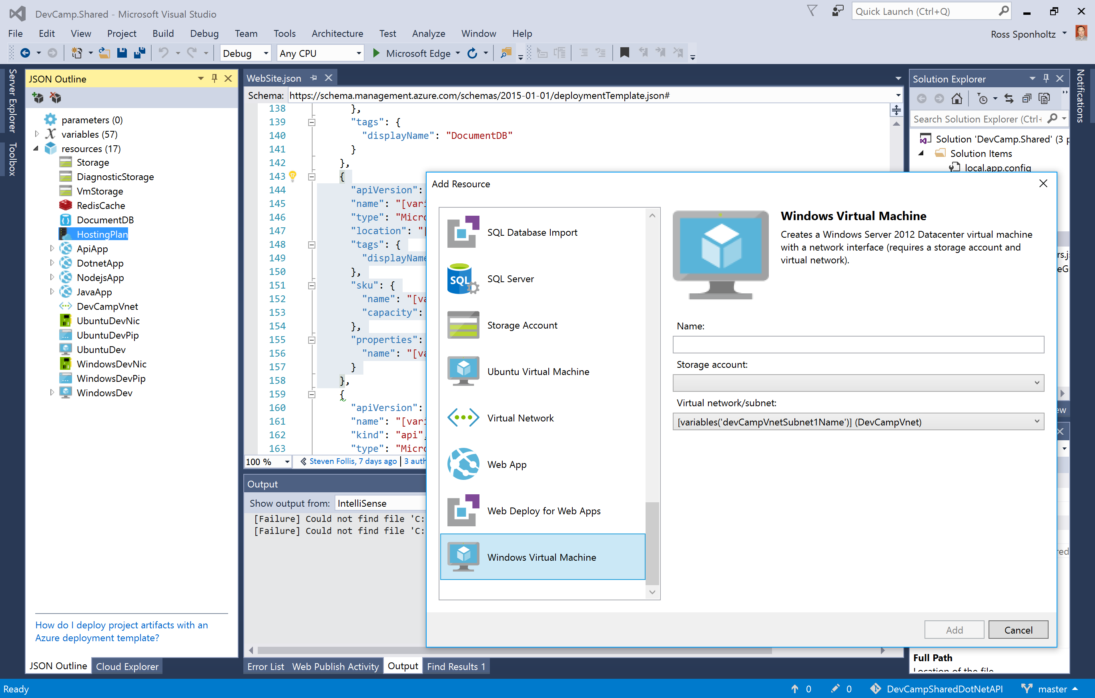
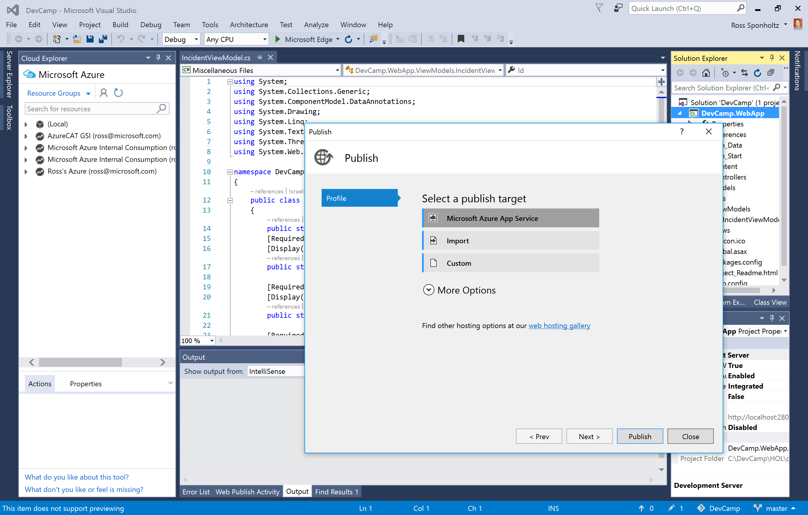
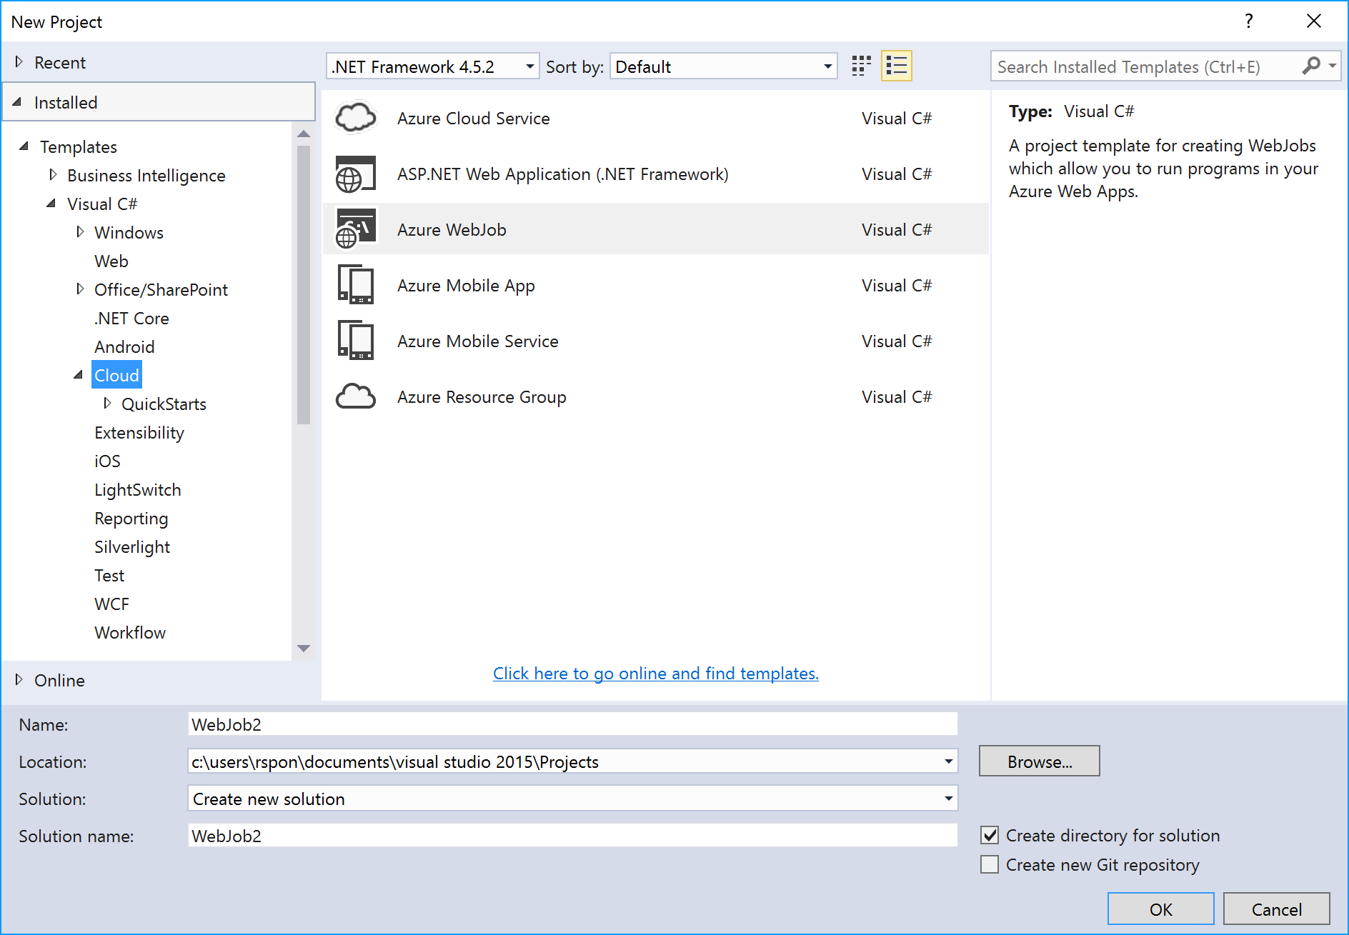
Visual Studio

Slide 20
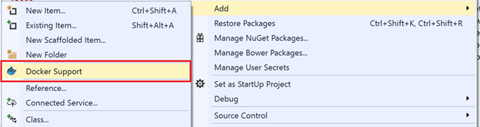
Docker Tools for Visual Studio 2015 (Preview)
https://aka.ms/DockerToolsForVS
Adds Dockerfile & scripts to project
Deploy & debug in containers

Slide 21
Demo
Visual Studio and Azure
Notes:
Azure and Visual Studio - 20 min - Mikkel
Easy repeatable provisioning of resources - Infrastructure as Code
Show ARM tooling
Get from VS to the Cloud in sub zero seconds…
Publish website to Azure (website and DB without the NPM)
Interact with the cloud without leaving VS
Azure resource interaction from Cloud Explorer
Easy repeatable build, test and deployment - CI/CD pipeline
VSTS git, build and release
Test is release x
Production is release x-1
Release to production

Slide 22
Java + Azure

Slide 23
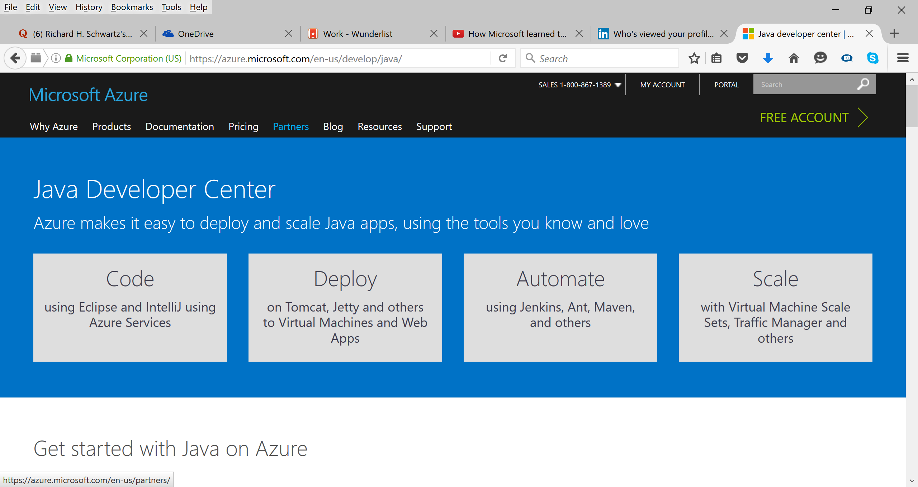
Java Dev Center – azure.com/java

Slide 24
Java deployment in Azure
IaaS
PaaS
Virtual Machines
VM Extensions
+ Containers
VM ScaleSets
Cloud Foundry,
Container Services
Service Fabric
Bring your Java
Automate everything
Elastic Declarative
Stateless & Stateful
Ultimate
Control
Cost &
Agility

Slide 25
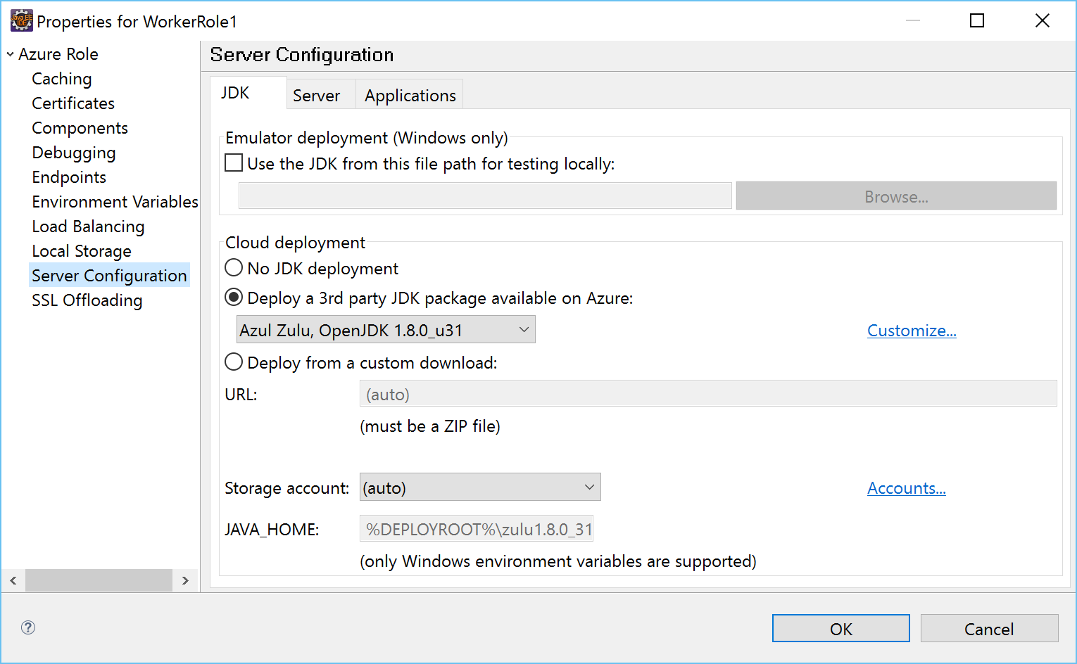
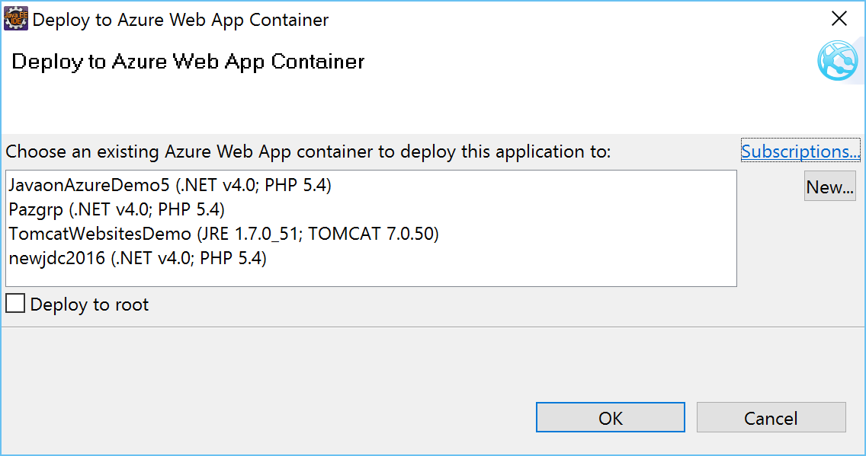
Azure Toolkit for Eclipse/for IntelliJ
Deploy to Azure Web Apps or Azure PaaS

Slide 26
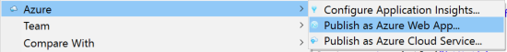
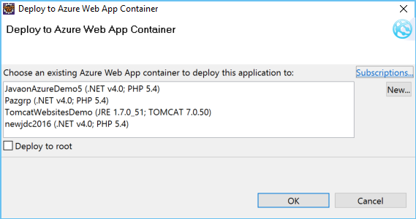
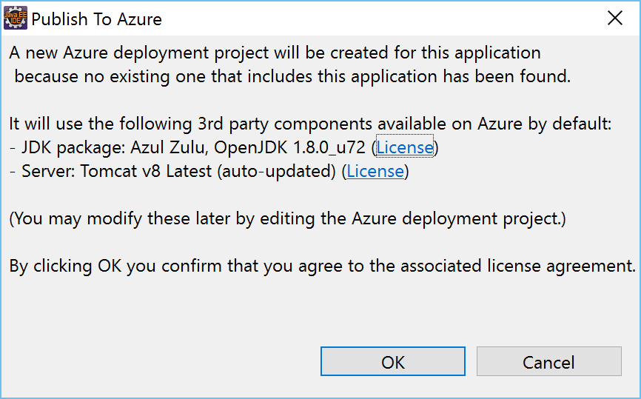
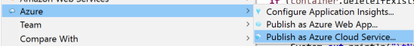
Azure Toolkit for Eclipse/for IntelliJ

Slide 27
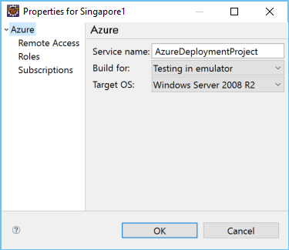
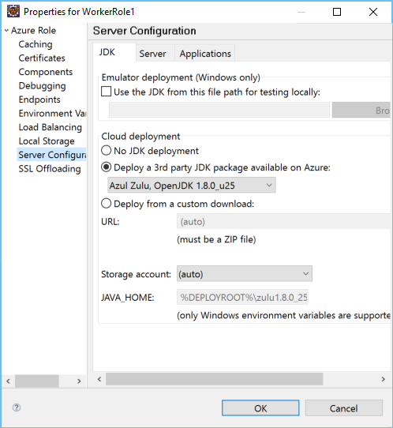
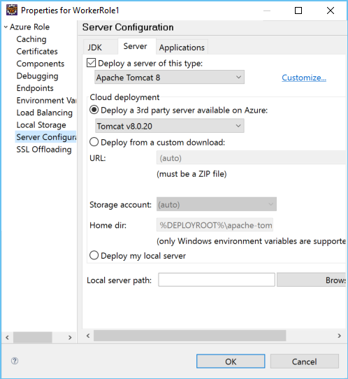
Azure Toolkit for Eclipse/for IntelliJ

Slide 28













SDKs for Java
Storage
Active Directory
Full developer ecosystems in Azure for your deployment needs and beyond
Key Vault
ApplicationInsights
Resource Manager
DocumentDB
SQL Database
SQL Azure
Web Apps
Data Lake
Media Services
Management
Scheduler
Service Bus
Notification Hubs

Slide 29
Node.js + Azure

Slide 30
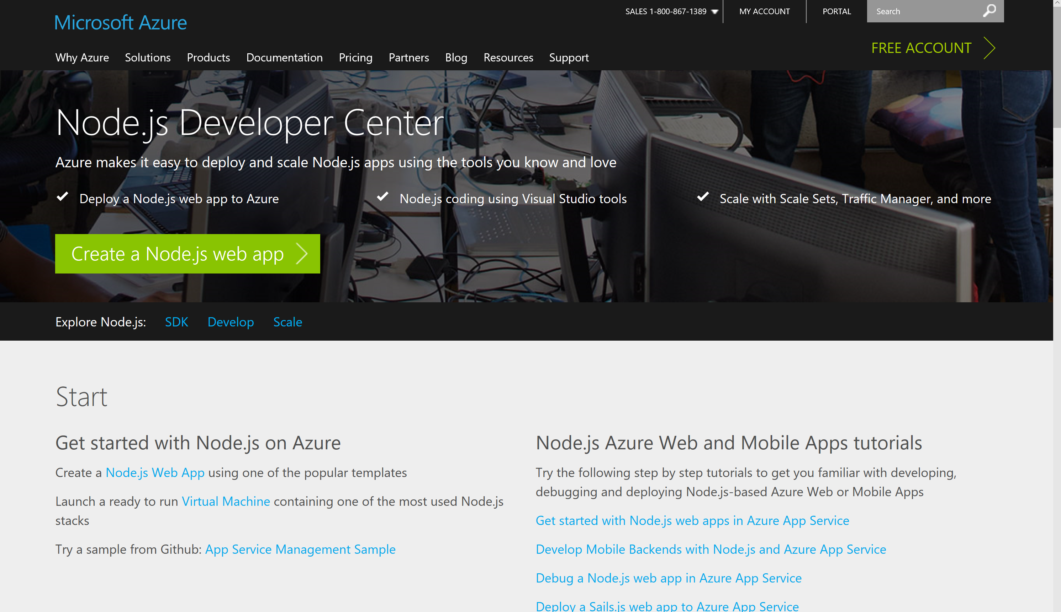
Node Dev Center – azure.com/node

Slide 31
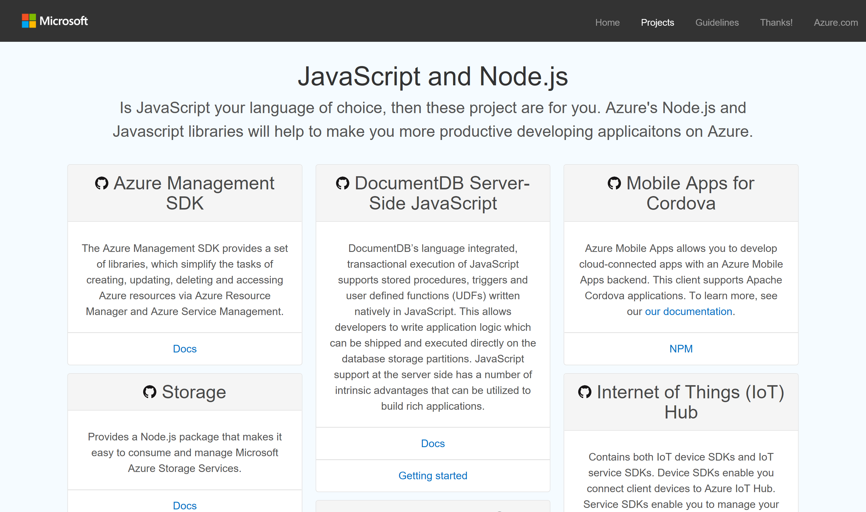
azure.github.io

Slide 32
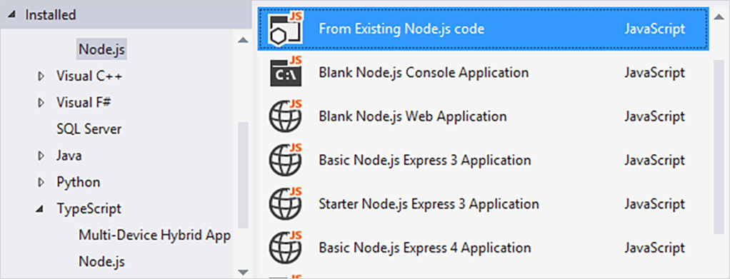
Node.js tools for Visual Studio
https://github.com/Microsoft/nodejstools#readme
editing, Intellisense, profiling, npm, TypeScript,
debugging locally and remotely (Windows/MacOS/Linux), as well
Azure Web Sites and Cloud Services.

Slide 33
SDKs for Node
Storage
Active Directory
Full developer ecosystems in Azure for your deployment needs and beyond
Key Vault
ApplicationInsights
Resource Manager
DocumentDB
SQL Database
SQL Azure
Web Apps
Data Lake
Cognitive Services Coming Soon !!!
Media Services
Management
Scheduler
Service Bus
Notification Hubs

Slide 34
Demo
Azure Command-Line Interface (CLI)
Notes:
Azure CLI - 20 min - Kamal
CLI Announcement
Get started and personalize
Install, config, account
Be productive
VMlist
Query with grep
Get easy insights
Website log tail

Slide 35
CI/CD/DevOps

Slide 36

DevOps is the union of people, process, and products to enable continuous delivery of value to our end users.
http://bit.ly/WhatIs-DevOps

Slide 37
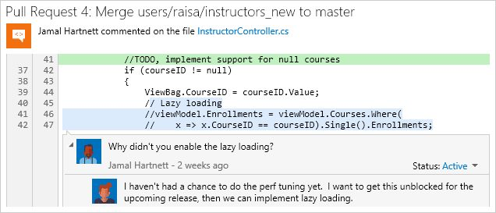
Visual Studio Team Services (VSTS) / TFS
Version Control
Git and Team Foundation Version Control (TFVC)
Unlimited private repos
Agile Planning
Work item tracking
Kanban, backlogs, task boards
Continuous Integration
Cloud-hosted build agents
Build support for all mobile platforms
Integration with test clouds

Slide 38

Jenkins Plugins
Azure Storage plugin for Jenkins
Easily deploy artifacts to Azure Storage
Jenkins Slave Plugin for Azure
Azure Cloud Profile Configuration
Azure subscription info
Deploy and manage Azure Slaves
Azure Slave Template Configuration
Azure Slave Templates tell Azure what type of Azure Slave to deploy
Windows or Linux
https://wiki.Jenkins-ci.org/display/JENKINS/Azure+Slave+Plugin

Slide 39
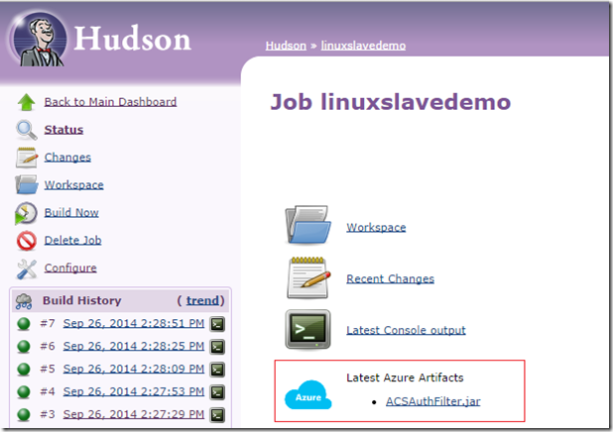
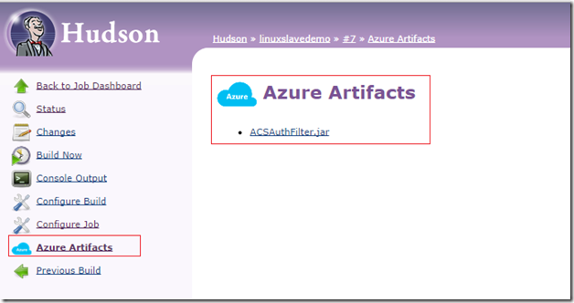
Hudson Storage plugin
https://github.com/hudson3-plugins/windows-azure-storage-plugin

Slide 40
Developer Benefits

Slide 41

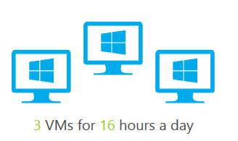


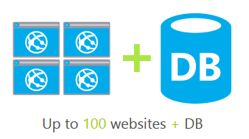
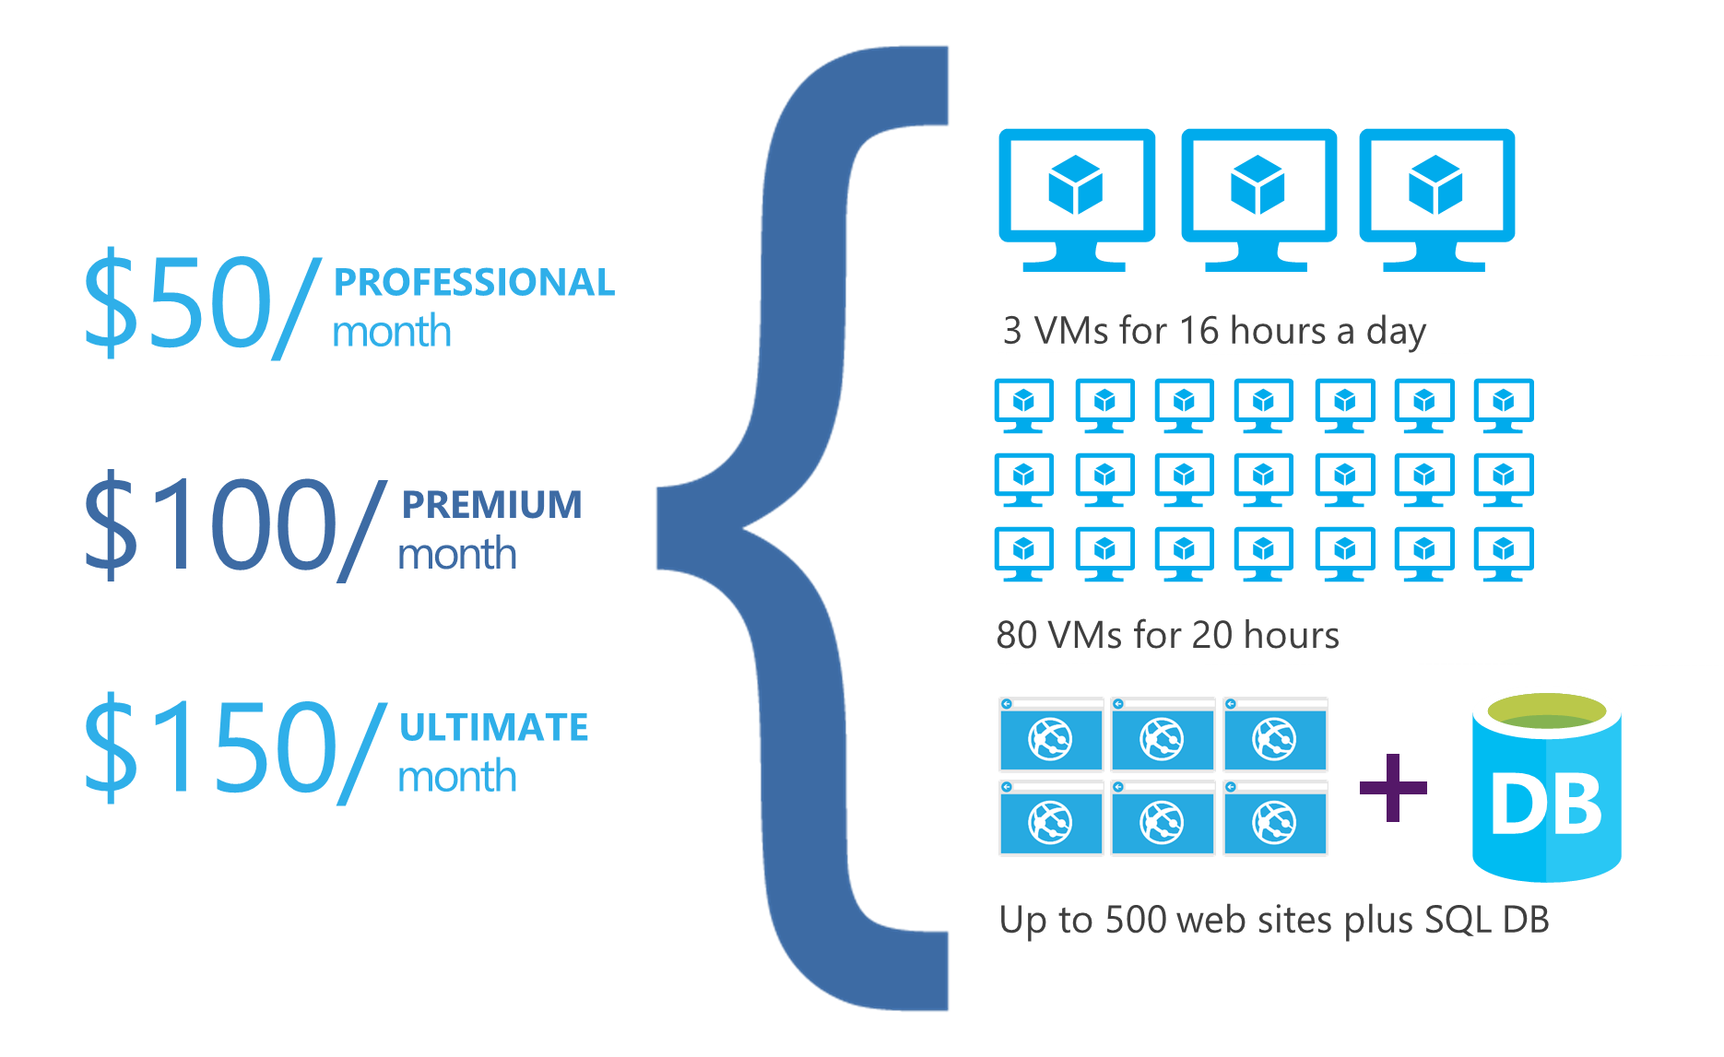
DEV ESSENTIALS
Microsoft Azure benefits
$25/month
Visual Studio Dev Essentials (free)
Not a Visual Studio subscriber? Get a $25 monthly Azure credit by joining Visual Studio Dev Essentials
3 VMs for 8 hours a day
40 VMs for 20 hour load test
25 HDInsight nodes for 10 hours
Up to 50 websites + DB
Visual Studio subscription (paid, MPN, or BizSpark)
Try out different Azure services, experiment, and learn
Provision developer machines with Visual Studio VMs in Azure
Great for individual dev/test workloads
Each Visual Studio subscriber gets up to $150 per month to use for dev/test in Azure
No charge for software installed for dev and test, plus access to subscriber-only VM gallery and special dev/test rates on HDInsight, Web Apps, and Cloud Service instances
PROFESSIONAL/TEST PROFESSIONAL
$50/month
MSDN PLATFORMS
$100/month
ENTERPRISE
$150/month
Notes:
Talking Points
Visual Studio Dev Essentials provides a fully-customizable experience, adaptable to the new developer needs of learning and adopting new technologies, choosing the most suitable solution for the problem on hand and enables a highly productive build, measure and learn dev/test/production lifecycle. You can get a $25 monthly Azure credit by joining Visual Studio Dev Essentials for free. For more information on Visual Studio Dev Essentials: https://www.visualstudio.com/en-us/products/visual-studio-dev-essentials-vs.aspx
Visual Studio subscription: When you purchase a Visual Studio subscription (formerly called MSDN subscriptions) you get a variety benefits from software, services, training and developer accounts for submitting apps to the store. The monthly Azure credit for Visual Studio subscribers provides an easy, low-risk, low-friction path for cloud adoption. If you already have a Visual Studio subscription, activate your Azure benefits and start building cloud apps today. For more information on monthly Azure credits for Visual Studio subscribers, visit: https://azure.microsoft.com/en-us/pricing/member-offers/msdn-benefits-details/

Slide 42
Developer Subscriptions
Office 365 Developer Site
Join the Office 365 Developer Program - http://dev.office.com
Windows Azure
This is going to be used for authentication to Office 365
Azure trial: https://azure.microsoft.com/en-us/pricing/free-trial/
Visual Studio
https://www.visualstudio.com/dev-essentials/

Slide 43
Getting Started Now
Developer portals
dev.onedrive.com
dev.office.com
OneDrive on GitHub
Samples and demos are available today
All the demos from this session are available on GitHub right now.
Use the SDKs
Graph SDKs are coming soon.
OneDrive SDK is available for .NET, iOS, Android, and Python.
These provide authentication, service discovery, and easy-of-use for the REST API on these platforms.

Slide 44
Office Platform
Engage
Follow us on Twitter - @OfficeDev
Provide feedback at User Voice - https://officespdev.uservoice.com
Interact on Stack Overflow - office-js, microsoftgraph, office365api, office365connectors, excel-addins, outlook-web-addins, sharepoint-api

Slide 45
Questions?

